Slide 1
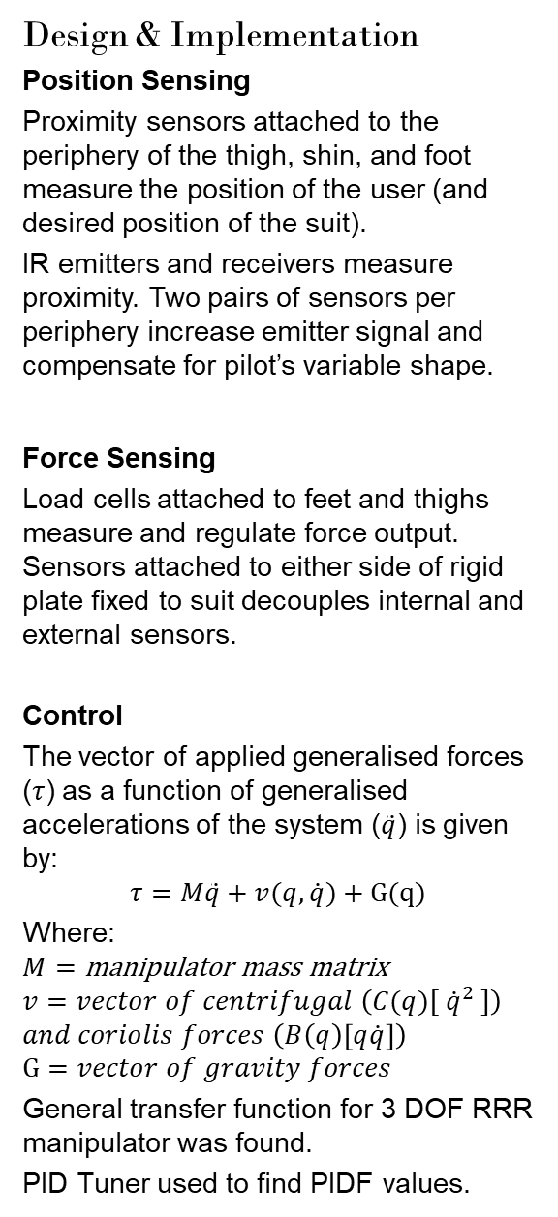
I AM FERROUS MAN
Samuel Williams & Dr Paul Pounds
Goals
Proof of concept for a position based exoskeleton control system.
Exoskeleton: A wearable machine used to augment the pilot’s physicality.
Background
Conventional exoskeletons use force based sensing to perceive the pilot’s desired position. Force based methods can be unstable and physically taxing.
Control can be accomplished by maintaining a constant offset between the suit and pilot.
Final proof of concept requires:
Stability while static (standing)
Movement (walking)
Regulated force application (sitting)
Accomplished by measuring and controlling the:
position of the pilot and the suit;
force applied by suit and pilot to suit;
actuator position and torque.
Scope
Creation of a lower extremity exoskeleton to demonstrate functionality.
Scope limited to perception and control.
System to measure suit force, and pilot force and position to determine torque required by actuators to maintain offset.
Design & Implementation
Position Sensing
Proximity sensors attached to the periphery of the thigh, shin, and foot measure the position of the user (and desired position of the suit).
IR emitters and receivers measure proximity. Two pairs of sensors per periphery increase emitter signal and compensate for pilot’s variable shape.
Force Sensing
Load cells attached to feet and thighs measure and regulate force output. Sensors attached to either side of rigid plate fixed to suit decouples internal and external sensors.
Control
The vector of applied generalised forces ($τ$) as a function of generalised accelerations of the system ($\ddot{q}$) is given by:
$$τ=M\ddot{q}+v(q,\dot{q})+G(q)$$
Where:
$$M=\text{manipulator} \text{mass} \text{matrix}$$
$$v=vector of centrifugal \left(C(q)[ {\dot{q}}^{2} ]\right)$$
$$and coriolis forces \left(B\left(q\right)\left[q\dot{q}\right]\right)$$
$$G=vector of gravity forces$$
General transfer function for 3 DOF RRR manipulator was found.
PID Tuner used to find PIDF values.
Signal/Data Flow Diagram
Motor interface extends original scope.
Project Achievements
Position Sensors: TRCT5000 IR Transceiver selected and implemented. Firmware written, tested, and commissioned. Signal amplified by LM358AD Op Amp before being read by 12-Bit ADC of NUCLEO-F303K8.
Position of pilot relative to the suit, and control error (angle) is measurable.
Force Sensors: Load Cells (YZC-161B 50kg) in Wheatstone bridge configuration amplified by INA125PA Instrumentation Amplified calibrated and commissioned.
Force applied by pilot to the suit and force applied by the suit to the environment measurable. Control error (force) is measurable
Control: Control variables and parameters (PIDF) found using MATLAB PID Tuner for all three leg segments. General equations of motion and transfer functions found for 3 DOF RRR system (e.g. arms and legs).
Communications: Two UART channels per NUCLEO-F303K8 used to connect boards. Required boards (six) daisy chained and transmitting along the chain. System may be extended to any number of boards (e.g. full body suit).
Previous Controller
Next Controller
UART [Baud 9600]
UART [Baud 9600]
RX(PA3), TX(PA2)
RX(PA10), TX(PA9)
UART [Baud 9600]
UART [Baud 9600]
UART1
UART2
Messages [ASCII]
Messages [ASCII]
DMA
Messages [ASCII]
Control & Status
Memory
NUCLEO-F303K8 Controller Software
Messages [ASCII]
Proximity
(P1..P4)
PA4..PA7
Timer 3 Channel 1
Proximity (P1..P4) 0-5V
Control
LM358AD Op Amp x2
PWM Interface
50kHz
Load (Top, Bottom)
Signal (P1..P4) 0-5V
Digital Control
PA0, PA1
PB4
4x Vishay TRCT5000 IR Sensor
Voltage 50kHz
Load (Top, Bottom) 0-5V
Servo
2x INA125PA
Instrumentation Amp
Power 50kHz
Motor
Load (T1..T4, B1..B4)
PXY = GPIO Port X Pin Y
8x YZC-161B
50kg Load Cell

